Slide 1
Open ICU databases @ MIT: Past, Present & Future

Slide 2
Executive summary
Physionet
MIMIC
MIMIC-II
MIMIC-III
Recent news

Slide 3
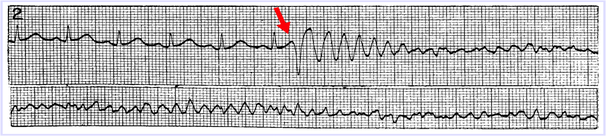
From Cottage Industry to Universal Standards
Arrhythmia detector research 1960’s-70’s – a “cottage industry”
Proprietary data for algorithm development and evaluation
Publicly distributed data
MIT-BIH Arrhythmia Database released publicly in 1980, 100,000 annotated beats from 48 Holter records
AHA Ventricular Arrhythmia Database – mid 1980s
Open data:
Facilitated algorithm evaluation
Encouraged competition
Resulted in standardized metrics
Accelerated development of arrhythmia
Value of open source data established

Slide 4
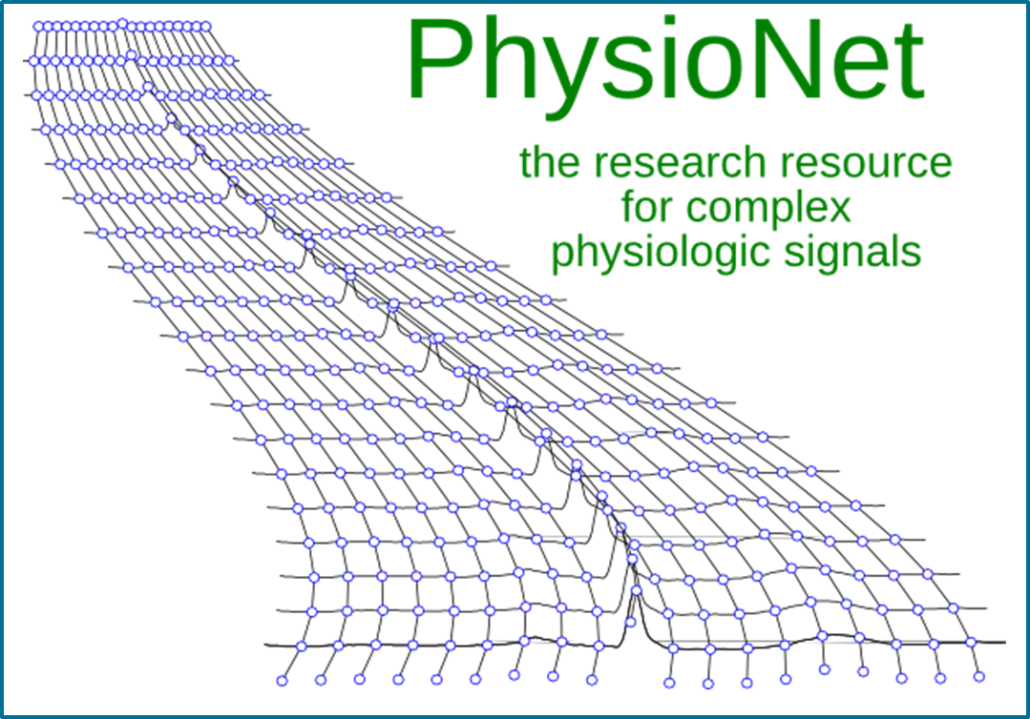
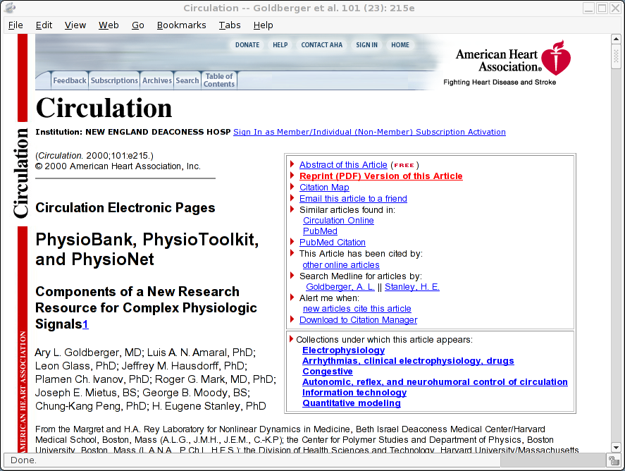
PhysioNet Established September,1999
Notes:
PhysioNet was founded in 1999 under the auspices of the National Center for Research Resources (NCRR) of the NIH, as part of their P41 Biotechnology program. Beginning in 2007, PhysioNet has been jointly funded by the National Institute of Biomedical Imaging and Bioengineering (NIBIB) and the National Institute of General Medical Sciences (NIGMS). PhysioNet’s primary investigators and staff are at Boston’s Beth Israel Deaconess Medical Center/Harvard Medical School and at the Massachusetts Institute of Technology (MIT).

Slide 5
What is PhysioNet?
A unique web-based resource designed to support current research and stimulate new investigations in the study of complex biomedical and physiologic signals.
Four closely interdependent components:
Data repository (PhysioBank)
Makes large collections of physiologic and clinical data available in open, Internet accessible, archives
Library of related software (PhysioToolkit)
Open-source software for exploration and analysis of physiologic data
Collaborative secure workspace (PhysioNetWorks)
Free-access website (physionet.org)
Notes:
This slide show introduces PhysioNet, a resource for researchers who study physiologic signals and time series, with attention to PhysioNet's significance to the NIH and its mission. We hope it will help those who need or wish to understand what PhysioNet is. These slides may be revised from time to time, but the most recent version can always be found at http://physionet.org/NIH/.

Slide 6
What is PhysioBank?
PhysioBank currently includes:
>40 collections of cardiopulmonary, neural, and other biomedical signals from healthy subjects and patients with a variety of conditions with major public health implications, including sudden cardiac death, congestive heart failure, epilepsy, gait disorders, sleep apnea, and aging.
Notes:
In all, PhysioBank's collections contained over 7000 recordings (about 220 GB of digitized signals and time series) as of January 2008. Individual recordings range in length from minutes to weeks, and contain from one to thirty simultaneous signals.

Slide 7
Where Do the Data Collections Come From?
PhysioNet research team members
Other university-based research teams
Other hospital-based research teams
Industry
You! (email webmaster@physionet.org)
Notes:
Your contributions are welcome and appreciated!

Slide 8
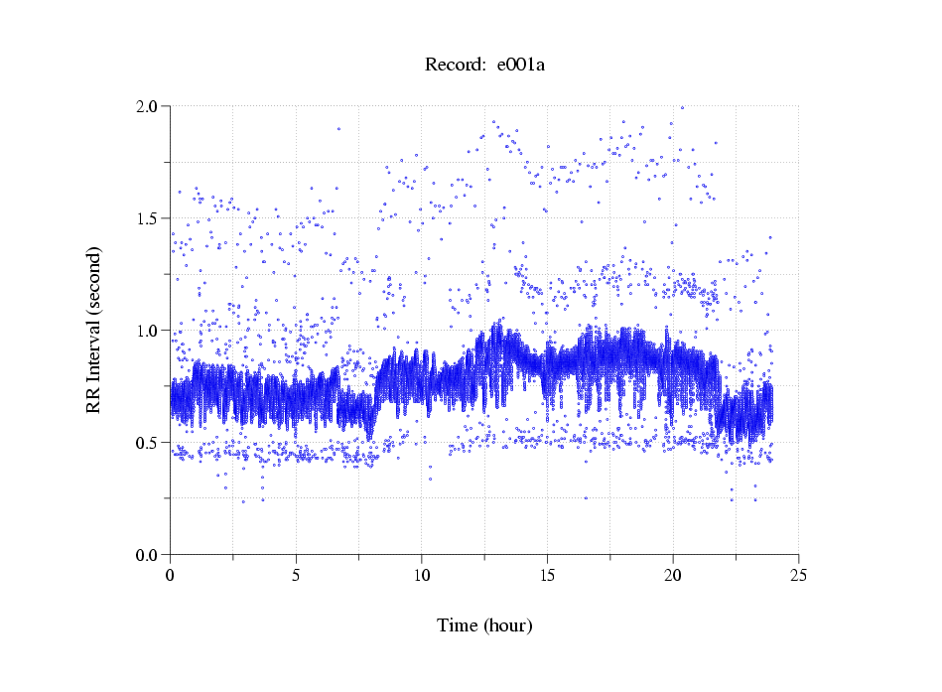
Example of a PhysioBank Dataset
Record e001a
Record e001a
Physiologic time series, such as this series of cardiac interbeat (RR) intervals measured over 24 hours, can capture some of the information lost in summary statistics.
RR interval (seconds)‏
RR interval (seconds)‏
Time (hours)‏
Time (hours)‏
Data from the NHLBI Cardiac Arrhythmia Suppression
Trial (CAST) RR Interval Sub-study Database
Notes:
This is one of over 1500 such 24-hour RR interval time series in the CAST RR Interval Sub-Study Database, which was contributed to PhysioNet in 2004. CAST (the Cardiac Arrhythmia Suppression Trial) was a landmark NHLBI-sponsored multi-center study of the late 1980s. Although considerable effort was invested by the CAST study group in manually correcting beat detection errors, it is certain that some remain; since the CAST investigators did not preserve the digitized ECG signals that they analyzed, it is not only impossible to locate these errors (or to validate specific intervals as correct), but it is also impossible to study other features of the ECG, such as QT intervals, ST levels, T-wave alternans, or atrial activity. This database is a unique and valuable resource despite its lack of raw signals. An important part of PhysioNet's mission is to encourage and enable preservation of raw data to permit their reuse in ways that may have been unanticipated when they were collected.

Slide 9
What Can You Do with PhysioBank Data?
Download for exploration and research
Develop new signal processing algorithms
Evaluate algorithms using ‘standard’ data
Test physiologic models
Develop/test/refine new biomarkers
Create “real-world” classroom challenges at undergraduate, graduate and post-graduate levels
Notes:
PhysioBank provides open access data for students and investigators at all levels for exploration, hypothesis generation and testing, and discovery.

Slide 10
What is PhysioToolkit?
Open-source software for physiologic signal processing and analysis:
Detection of physiologically significant events using both classical techniques and novel methods
Interactive display & characterization of signals; creation of new databases
Physiologic signal modelling and for quantitative evaluation and comparison of analysis methods
Notes:
PhysioToolkit is the open-source software component of the Resource.

Slide 11
Where Does the Open-Source Software Come From?
PhysioNet research team members
Contributions from individuals and teams around the world
PhysioNet/Computers in Cardiology annual Challenges
You! (email webmaster@physionet.org)
Notes:
Again, your contributions are appreciated.
The strength of the open-source model of software development is that any motivated reader can learn how any open-source software component works, at any desired level of detail – and, armed with that understanding, can improve it, modify it to suit another application, or use it as a model to create something entirely new and unanticipated by the original author.
Take what is already provided in PhysioToolkit and make it better, or make something new, and share it with the PhysioNet community.

Slide 12
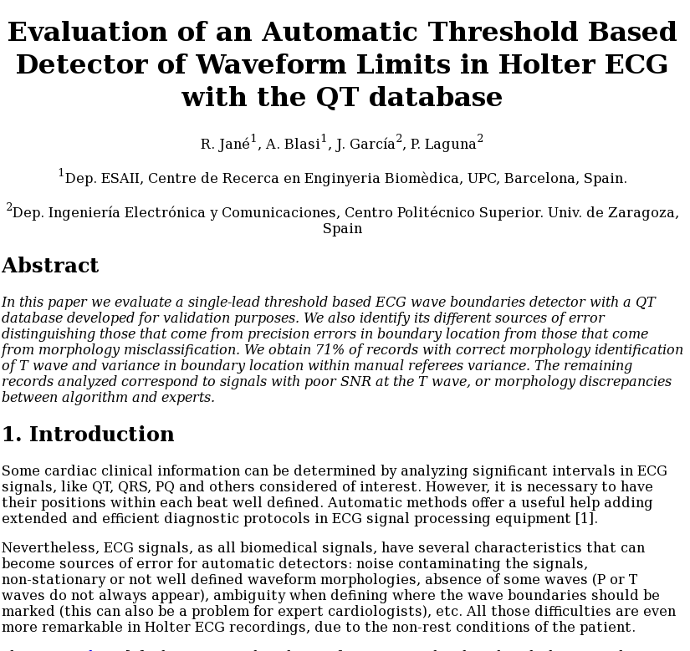
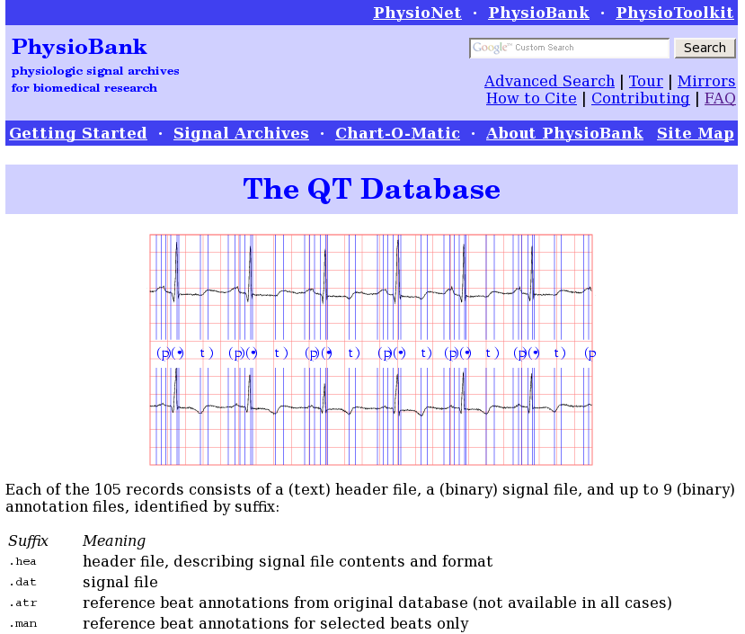
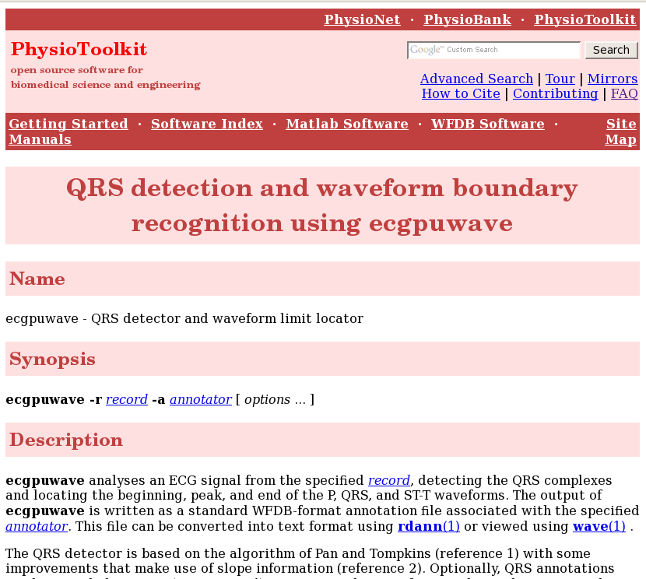
Some PhysioNet Contributions Include
Both Data and Software
Manuscript
Data
Software
Notes:
The authors of this study contributed both their open-source software for locating boundaries of ECG waveforms (the onset, local extremum, and end of the P, QRS, and T waveforms), and the reference data they used to evaluate their software. In so doing, they provided what has become a widely-used tool that can be applied to other researchers' ECGs to extract accurate and important information that is difficult to obtain otherwise, and they provided data that can be used to measure and compare the accuracy of their algorithms and others.
In this case, there was no generally available reference data set appropriate for evaluating algorithms of this type.

Slide 13
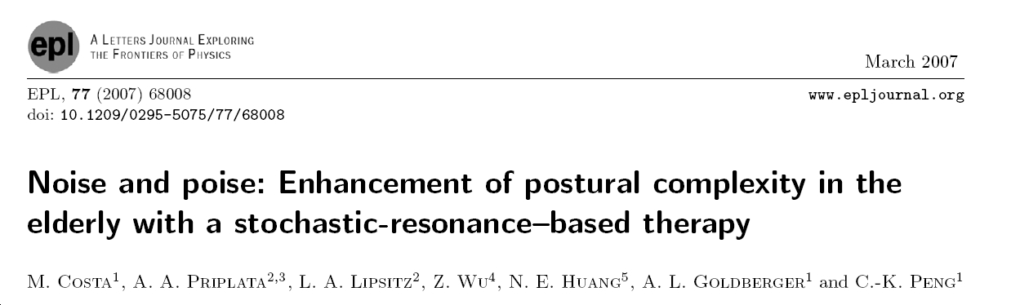
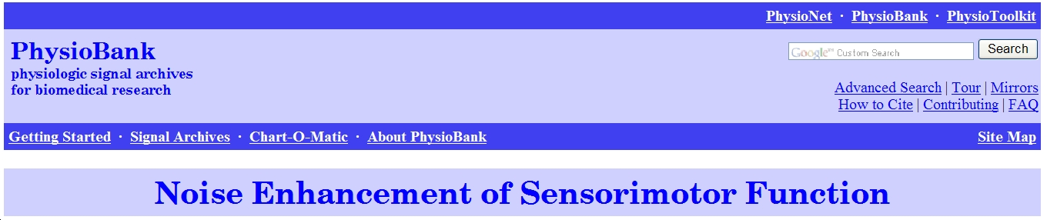
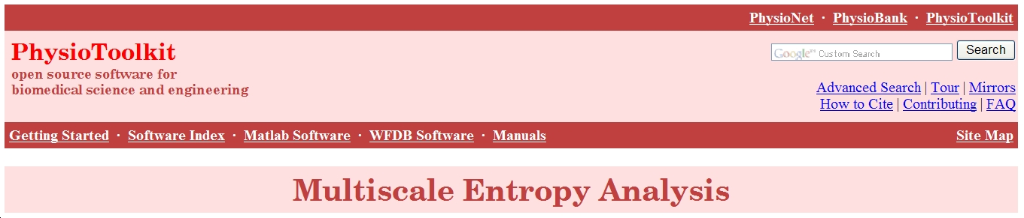
More Contributions with Data & Software
Manuscript
Data
Software
Notes:
This is another example of a peer-reviewed publication for which the original data and software are available at the Resource.

Slide 14
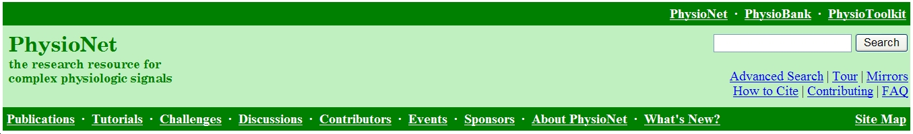
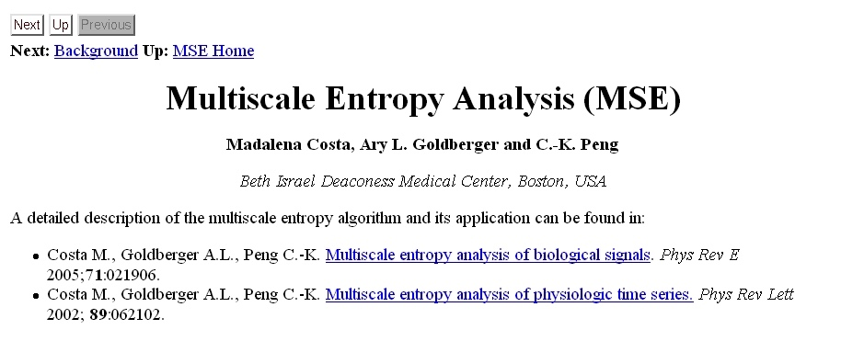
PhysioNet Provides Tutorials on Complex Signal Analysis
Downloads since 2004: MSE code 4,208; MSE tutorial 7,432
Method featured in Nature News and Views 2002; 419:263.
Notes:
PhysioNet tutorials explain how to use the software tools for extracting information from complex biologic signals.
(Download statistics are as of September 2007.)‏

Slide 15
Impact of PhysioNet
Open access to:
> 4 TB of data in 51 collections, ~ 35,000 recordings
Data and software contributed by a wide range of investigators worldwide
Users:
Over 40,000 from all 50 states and more than 140 nations.
Visits
~ 4,000 per day
Downloads:
~ 290 gigabytes of data per day.
Publications:
~ 100 scholarly publications per month

Slide 16
MIMIC I
(Multi-parameter Intelligent Monitoring for Intensive Care) Database
1992 – 1999
Data acquisition from individual patients
IRB required patient/HCP consent
Special-purpose archiver via RS-232 connection
High quality data (500 s/s, 12 bit precision)
90 records, 40 hr. duration
Clinical data via manual abstraction of paper records

Slide 17
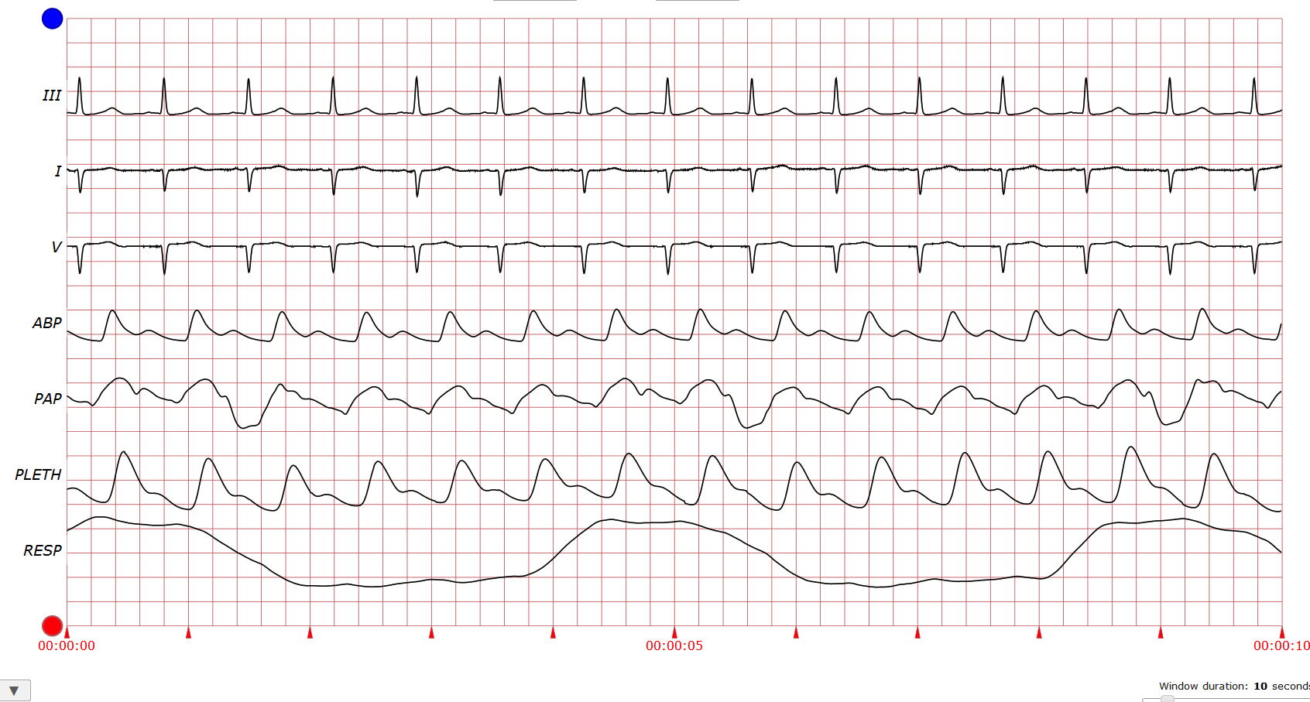
MIMIC I Data Sample Record 041

Slide 18
MIMIC II
(Multi-parameter Intelligent Monitoring for Intensive Care) Database
NIH grant awarded in 2003:
“The objective of this Bioengineering Research Partnership is … to develop and evaluate advanced ICU patient monitoring systems that will substantially improve the efficiency, accuracy, and timeliness of clinical decision making in intensive care.”

Slide 19
GOALS
Mirror the ICU environment in the laboratory
Waveforms, numerics, complete clinical data
Support:
Development and evaluation of algorithms for advanced patient monitoring and decision support
Retrospective clinical research in critical care
Make data public
Engage the creative energy of the world-wide research community

Slide 20
Partners
MIT faculty
Mark, Szolovits, Verghese
Beth Israel Deaconess Medical Center
Intensivists, IT department
Philips Healthcare

Slide 21
Optimal Environment at BIDMC
Well established high quality hospital information system built over 35 years
IT department and chief (John Halamka) very supportive
ICUs use Philips’ equipment:
Intellivue monitoring network
CareVue clinical information system
Information Storage Mart (ISM) – Oracle DBS

Slide 22
IRB Approval
IRB approval 2001 and annually thereafter
Waiver of informed consent
Data to be de-identified
Involves no risk to subjects
Waiver will not adversely affect the rights and welfare of the subjects
Research could not practicably be carried out without the waiver

Slide 23
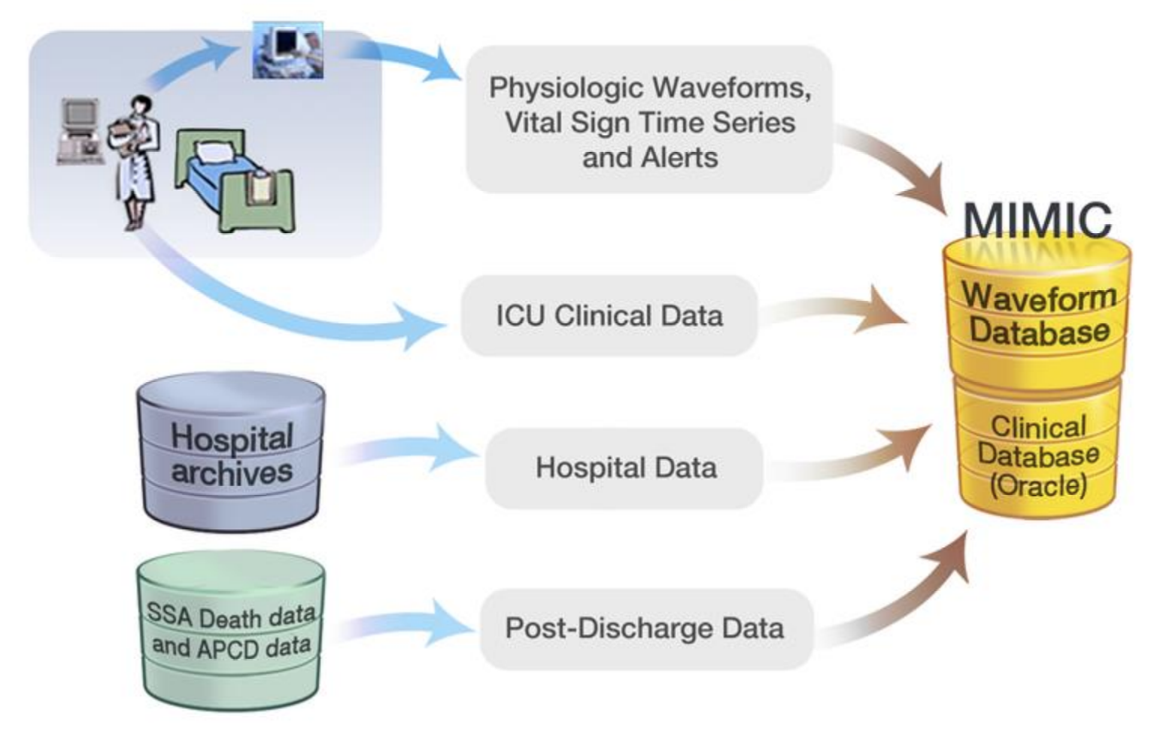
MIMIC II Data Acquisition
Notes:
Up to 4 (or 7) waveforms (125 Hz peak-picked) and up to 30 trends (1/minute) of multiple variables; alarms; inops; currently also beat annotations are acquired using Philips-supplied archiving agents
Clinical data from CareVue bedside workstations that are archived off site in an Oracle database (Information Storage Mart), that we copy at intervals. All data since 2001 through 2007 have been loaded into the first release of MIMIC II
Additional clinical data obtained from hospital archives, including all labs; radiology, echo, and ECG reports; ICD9 codes; discharge summaries; provider order entry data for pharmacy; microbiology reports; transfers and mortality in hospital;

Slide 24
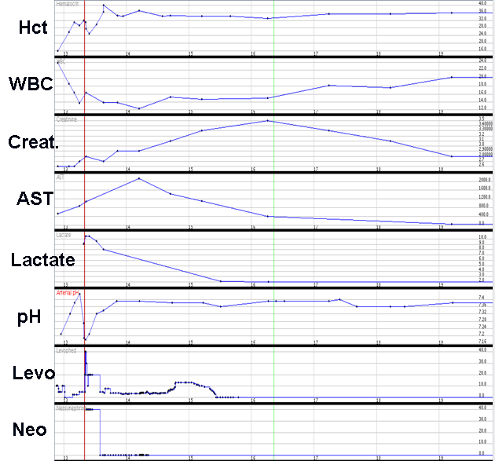
MIMIC II Contents (1)
Clinical Data for entire ICU stay & subsequent hospital admissions
Hourly physiologic measures
Laboratory results
Fluid balance
IV medications
Ventilator settings
Demographics
ICD-9 codes
Physician orders
Reports: radiology, echo, ECG
Nurse progress notes
Discharge summaries
etc.
1 Day
Notes:
The free text elements are in red.
Alanine transaminase (ALT) , Aspartate transaminase (AST) are LFTs

Slide 25
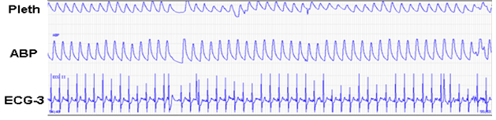
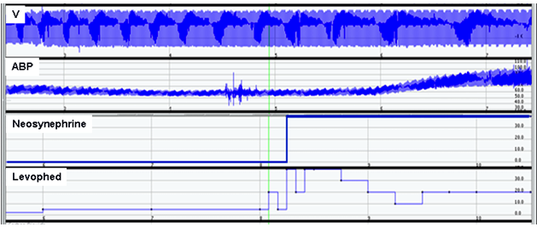
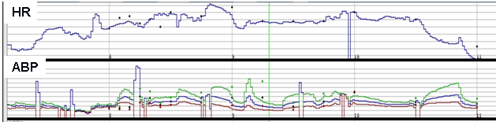
MIMIC II Contents (2)
Continuous Physiologic Data
Waveforms (sampled @ 125 Hz)
10-bit resolution
Waveforms with IV Medication
Record
Minute-by-minute trend of
physiological measurements

Slide 26
Automated De-identification of Free Text
PHI Lookup Tables
PHI Lookup Tables
PHI Lookup Tables
- Patient names
-
-
PID/patient names
PID/patient names
-
Doctor names
-
-
Doctor names
Doctor names
Non
-
PHIs
-
Hospital names
Non
Non
Non
-
-
-
PHIs
PHIs
-
PHIs
-
Hospital names
Hospital names
-
Company names
-
Company names
-
Company names
-
-
-
-
UMLS/
UMLS/
UMLS/
UMLS/
Snomed
Snomed
Snomed
-
Snomed
-
-
First, Last names
First, Last names
First, Last names
-
-
-
-
Common words
Common words
Common words
hpi
Common words
hpi
:
:
Mr.
Mr.
Costanzo
Costanzo
admitted in
admitted in
-
-
Locations
Locations
hpi
hpi
:
:
Mr.
Mr.
Costanzo
Costanzo
admitted in
transfer from Calvert Hospital
-
Locations
admitted in
transfer from Calvert Hospital
transfer from
transfer from
Calvert
Calvert
Hospital
on 8/16/1995 following a clinic ...
Hospital
on 8/16/1995 following a clinic ...
on
on
8/16/1995
8/16/1995
following a clinic ...
. pt of dr. randy
following a clinic ...
. pt of dr. randy
jones
jones
.
.
. pt of dr.
. pt of dr.
randy
randy
jones
jones
.
.
Heuristics
Heuristics
Heuristics
Lexical
Heuristics
meds:
Lexical
meds:
pt claims that he is
pt claims that he is
meds:
meds:
pt claims that he is
Matching
pt claims that he is
Match with UMLS and
Match with UMLS and
Match with UMLS and
-
Match with UMLS and
-
-
compliant .... ,
Matching
-
compliant .... ,
colace
colace
100mg
100mg
po
po
compliant .... ,
compliant .... ,
colace
colace
100mg
100mg
po
po
common words
common words
common words
qd
common words
qd
, methadone (methadone in
, methadone (methadone in
-
-
-
-
Apply simple rules
Apply simple rules
qd
Apply simple rules
qd
, methadone (methadone in
house has been
, methadone (methadone in
Apply simple rules
house has been
dc'd
dc'd
) his wife,
) his wife,
house has been
house has been
dc'd
dc'd
) his wife,
janice
) his wife,
janice
(508/334/5423) confirms
(508/334/5423) confirms
janice
janice
(508/334/5423)
(508/334/5423)
confirms
the story.
Pattern Matching with
confirms
the story.
the story.
Pattern Matching with
the story.
Pattern Matching with
Regular Expressions
Regular Expressions
Regular Expressions
hpi
hpi
:
:
[**Known patient name**]
Numeric Tokens
[**Known patient name**]
Numeric Tokens
Numeric Tokens
admitted in transfer from
-
Dates, phone numbers
admitted in transfer from
-
-
Dates, phone numbers
Dates, phone numbers
[**Hospital 1**] Hospital on [**2002
[**Hospital 1**] Hospital on [**2002
-
-
SSN, zip codes, MRN
-
-
-
SSN, zip codes, MRN
SSN, zip codes, MRN
09
09
-
-
02**] following a clinic ... pt of
Expressions with Indicators
02**] following a clinic ... pt of
Expressions with Indicators
Expressions with Indicators
dr. [**First Name 2**] [**Doctor Last
-
dr. [**First Name 2**] [**Doctor Last
-
More names and locations
-
More names and locations
More names and locations
Name 3**].
Name 3**].
meds:
meds:
pt claims that he is
PHI Indicators
pt claims that he is
compliant ...
compliant ...
colace
colace
100mg
100mg
po
po
qd
qd
,
PHI Indicators
,
methadone (methadone in house
-
Name:
Mr
methadone (methadone in house
-
Name:
Mr
, MS, Dr, son, wife, ...
, MS, Dr, son, wife, ...
has been
has been
dc'd
dc'd
) his wife, [**Name2
-
-
Location: Street, Road, Town,
…
) his wife, [**Name2
Location: Street, Road, Town,
-
Age:
y.o
., years old,
yo
,
…
…
4**] [**Telephone/Fax 5**]) confirms
-
Age:
y.o
., years old,
yo
…
4**] [**Telephone/Fax 5**]) confirms
the story.
Mark words before/after indicators
the story.
Mark words before or after
Indicators as potential PHI
as potential PHI
Notes:
Notes scanned word-by-word. Matching against dictionary-based look-ups and regular expressions for numeric patterns.
Names- 1)lexical matching with known PHI tables for patient and doctor names; 2) lexical matching with name collections. Here “unambiguous” means name not on UMLS (Unified Medical Language System) list or common word list. If ambiguous, use heurisitcs for patterns. 3) context check used around words such as Mr., Dr., son, etc. 4) Name instances maintained for each record, and repeat scan used to catch names that escaped detection the first time through.

Slide 27
Performance on Reference Corpus
(350,000 words from 2,785 nursing progress notes)
Recall (Sens.)
Precision (PPV)
Single MD
Avg
0.81
0.98
Min
0.63
0.95
Max
0.94
1.00
Team of two MDs
Avg
0.94
0.97
Min
0.89
0.95
Max
0.98
0.99
Team of three MD’s
Avg
0.98
0.97
Min
0.98
0.95
Max
0.99
0.99
Algorithm
0.97
0.75
FN rate – 2 per 10,000 words No patient names missed
(BMC Medical Informatics and Decision Making 2008, 8:32)

Slide 28
MIMIC II – v2.6
ICU admission records – 40,426 (2001 – 2008)
32,332 adults
8,087 neonates
Distribution (adults)
MICU - 40%
SICU – 25%
CSRU – 19%
CCU – 15%
Hospital mortality (percent of unit stays) = 11.7%
Records with matched waveforms & trends ~ 5,000
Database size
Waveforms ~ 4 TB
Clinical ~ 200 GB

Slide 29
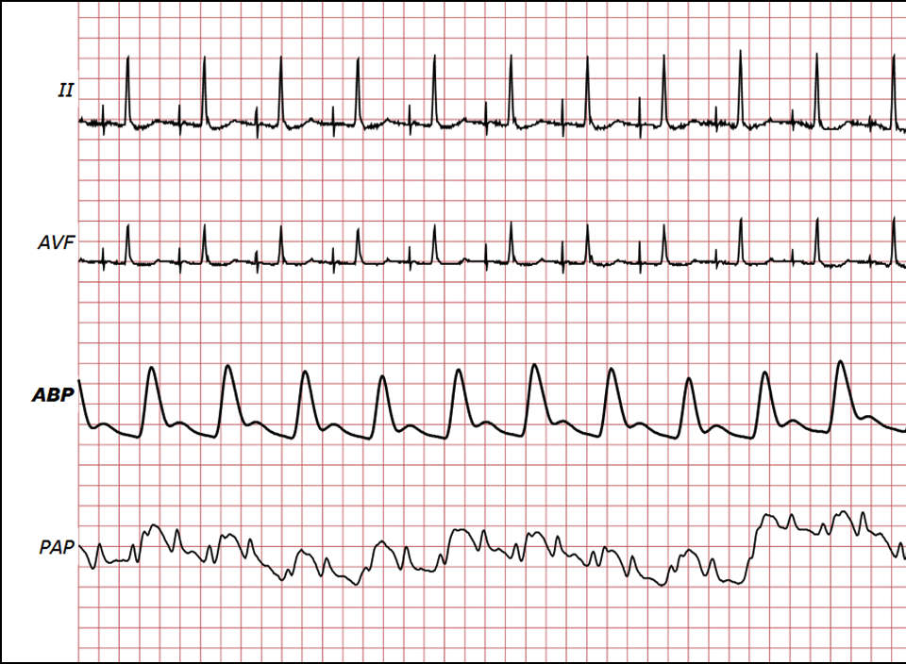
“Open” MIMIC II
Over 23,000 waveform records have been posted on PhysioNet - durations from days to several weeks. Free access to all.
http://physionet.org/physiobank/database/mimic2db/
Full MIMIC II database is freely available, subject only to a
data use agreement.
Total current users ~ 950
www.physionet.org/cgi-bin/request
I will not attempt to identify any individual in the DB
I will not share access to data with anyone else
I will maintain physical and electronic security of the data
If I find any PHI I will report its location so it can be removed
My purpose is lawful research

Slide 30
Impact
Publications
More than 100 peer reviewed articles in top medical journals
Clinical outcome
Limited! All studies are “single center”, which is the primary drawback of all these papers

Slide 31
Vision and recent news

Slide 32
Our Vision for MIMIC III
Collaborate with colleagues to build a multi-institutional, international archive of highly granular critical care data that is open to all, and fully extensible.
Generate new knowledge and new clinical tools to benefit patient care.
Challenges to solve:
Technology development
Institutional support re data release
Long-term funding

Slide 33
Version 3.0 Estimated release April 1, 2014
Covers 2001 – 2012
Adds 23,800 additional adult ICU admissions
Incorporates new data from MetaVision
Physician notes
Medication administration
Includes more complete hospital data
CPT codes
ADT files
Demographics/Admission data
Reorganized, more denormalized table structure

Slide 34

A final observation

Slide 35
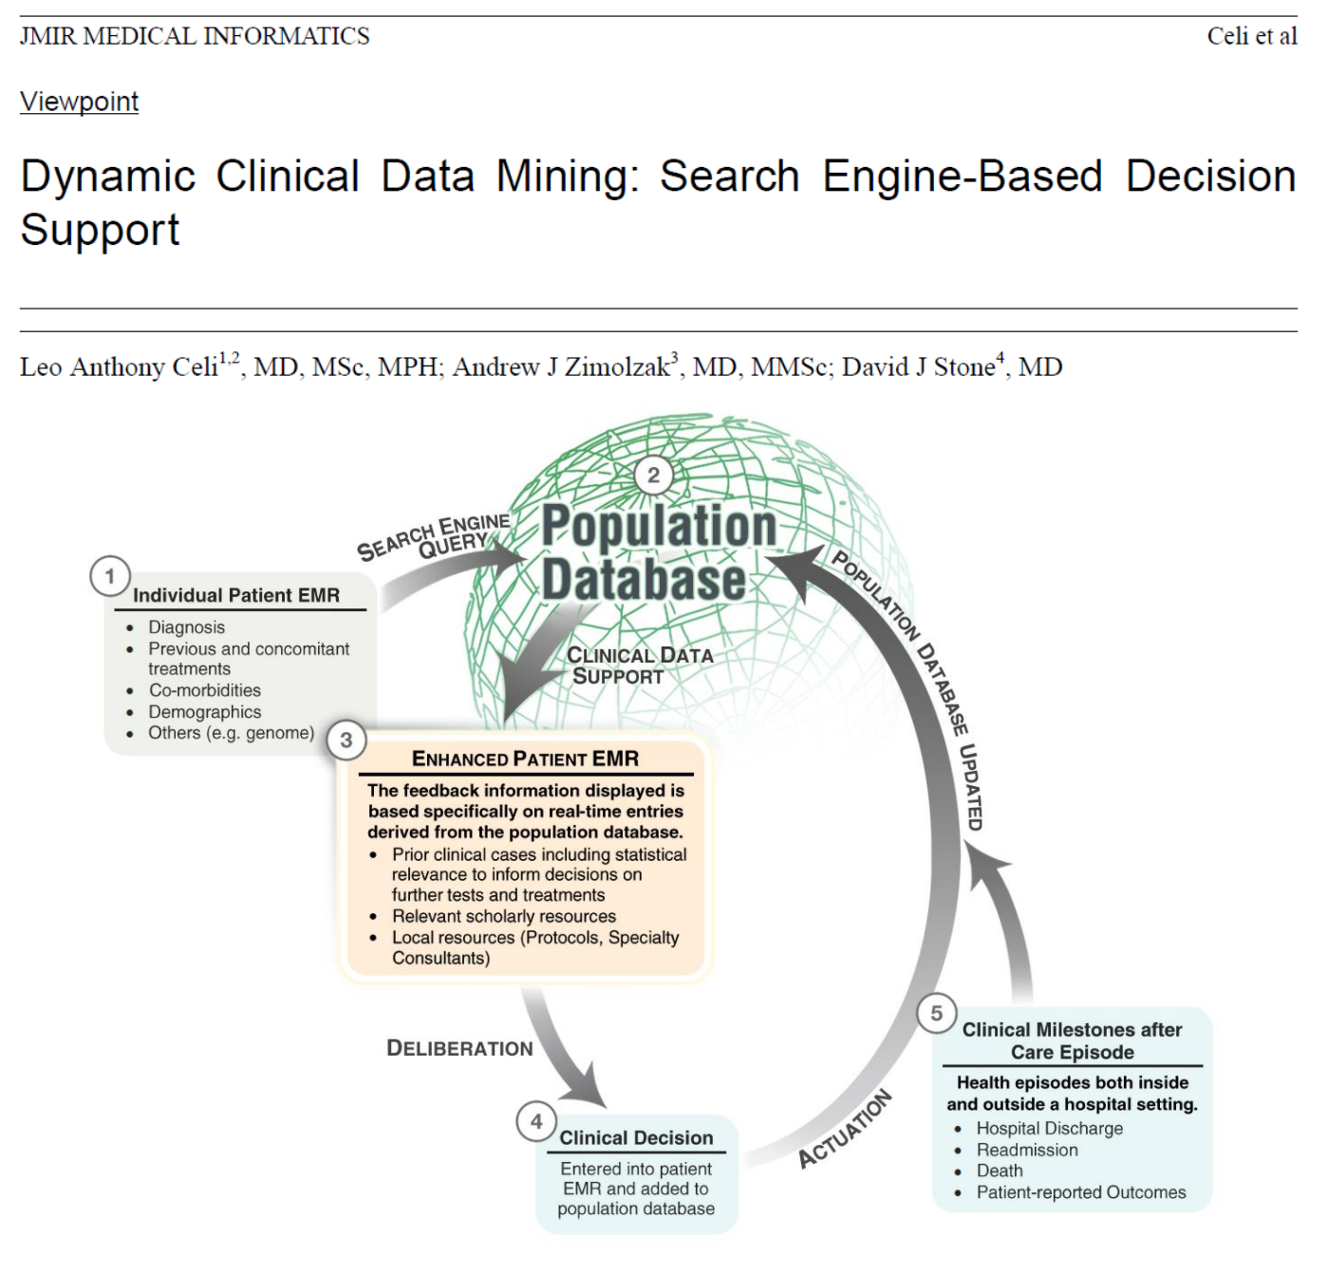
An attempt to structure the response

Slide 36
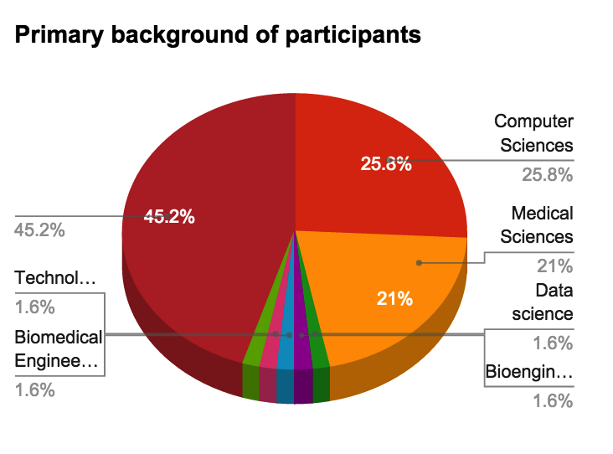
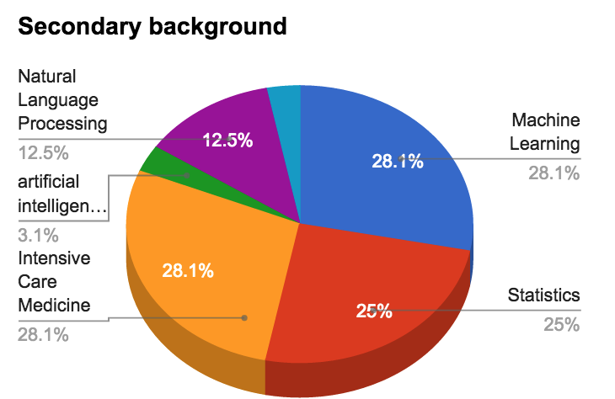
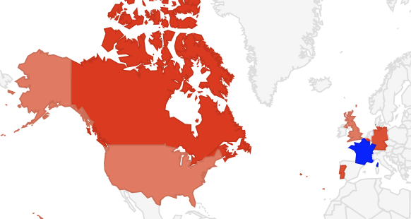
Paris data marathon – March 2012

Slide 37
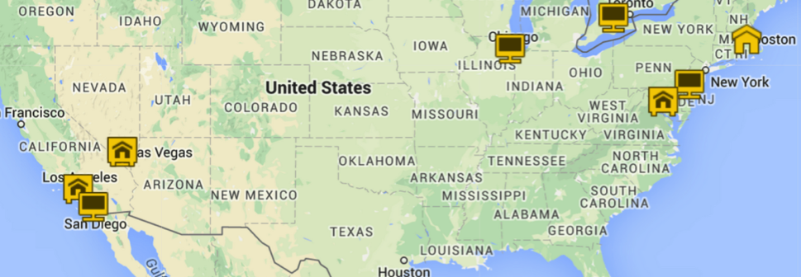
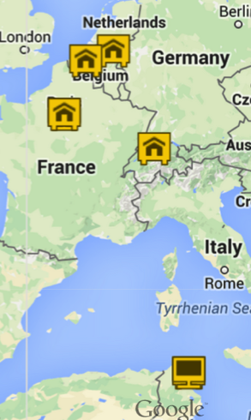
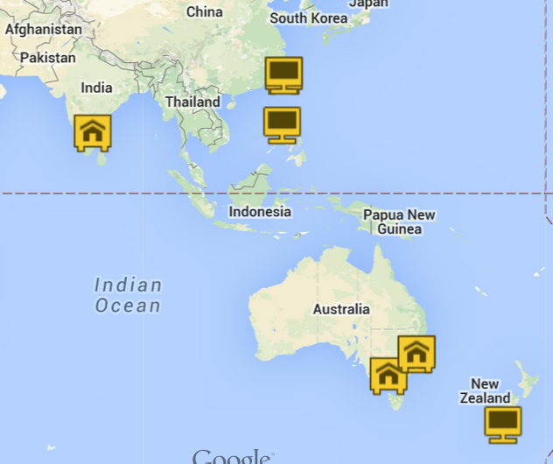
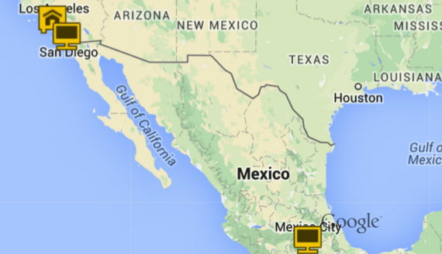
Boston – Jan. 2013

Slide 38
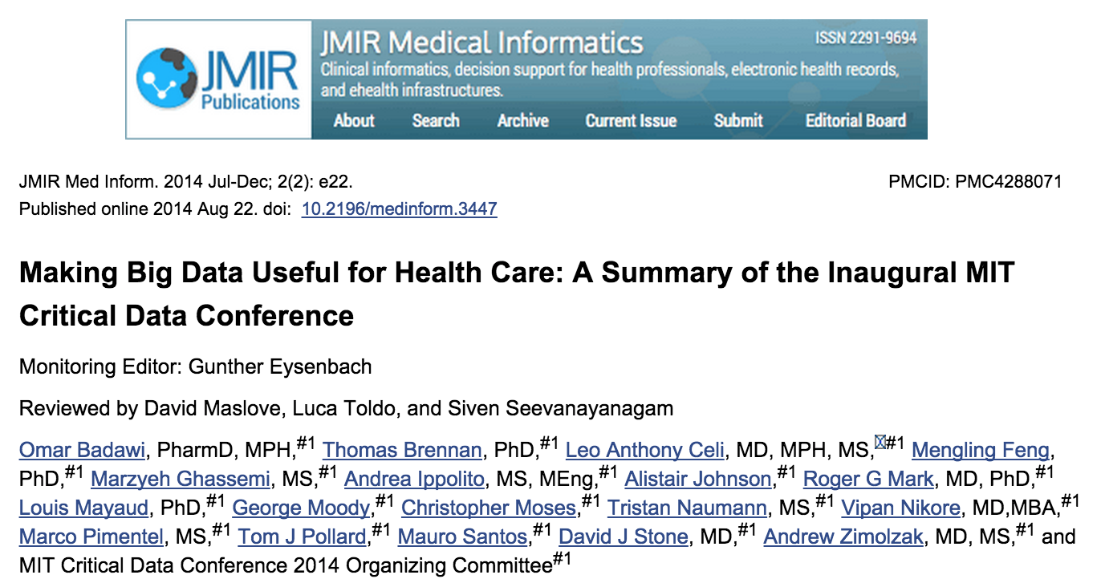
Paris – London –Boston 2014
Although the future of “big data” in health care remains unclear, its role will be undeniably important. This conference was effective in collating the broad range of perspectives on the many challenges facing EBM in the 21st Century. As several speakers suggested, one possible opportunity is to adopt a pragmatic approach to EBM, combining RCT and ROS. This combination may employ ROSs to fill the gaps where it is impractical, unlikely or impossible to conduct a RCT or to drive hypothesis generation for further RCT analysis.

Slide 39
Some questions investigated
What are the long-term prognostic indicators in patients with prolonged multi-organ failure in the ICU?
Are there particular pre-hospital medications that increase the risk of adverse events in patients admitted to the ICU with sepsis?
What are the risk factors for the development of late acute respiratory failure or acute kidney injury in the ICU patient.
What factors are predictive of increased morbidity and mortality in elderly patient admitted to the ICU?
What factors are predictive of outcome/prognosis in patients with sepsis, and can we stratify this risk in a way practical for comparison in the research environment?
Can we predict which patients likely will not benefit from advanced and invasive therapies in the ICU (eg CVVH and mechanical ventilation)?
Identifying leading factors of complications during the management of hyperglycemia in ICU settings.
Does delirium by itself indicate worse ICU outcome in sepsis?
Duration and degree of leukocytosis and its association with ICU outcomes.
Pre-admission treatment with Lisinopril or diuretics and rates of AKI in ICU.
Are there more adverse events in patients with lower MAPs than in MAPs>65?
Are non-cirrhotic alcoholics who present with sepsis at greater risk of poor outcomes in the ICU?
What are the adverse outcomes associated with abnormal electrolytes in the ICU?
Are there significant differences in outcomes based on choice of “third pressor” ?
What are the long term outcomes for patients with Ogilvies (colonic psuedoobstruction); are there differences based upon type of treatment?
Is the concomitant administration of IV metronidazole (Flagyl) protective against C. Diff infections in septic patients?
Can we predict which patients are at higher risk of ICU-acquired weakness ?
Is there an increase risk of infection with blood transfusions?
Obesity paradox in ICU patients ?

Slide 40

Phillips
This includes many data sources, such as patient records, that may be written in ordinary language.
One significant benefit of the MIT-Philips alliance, Szolovits says, is to help academic research find applications beyond the publication of papers.
“One of the things I’m really looking forward to, since they [Philips] are actually making stuff that gets used in hospitals around the world, is that they will develop some of these ideas,” Szolovits says. “That, in turn, would allow MIT students and faculty to do follow-up studies on ‘how well these things work in the real world.’”
+2 million patients

Slide 41

Belgium consortium
The M@tric database is an archive of structured data from ICU patients admitted to university hospitals in Ghent, Leuven and Antwerp. It is similar to MIMIC in terms of resolution of the structured data but lacks waveforms, notes and reports in free text, as well as survival data past the hospitalization. It is slated for release by the end of 2015.

Slide 42
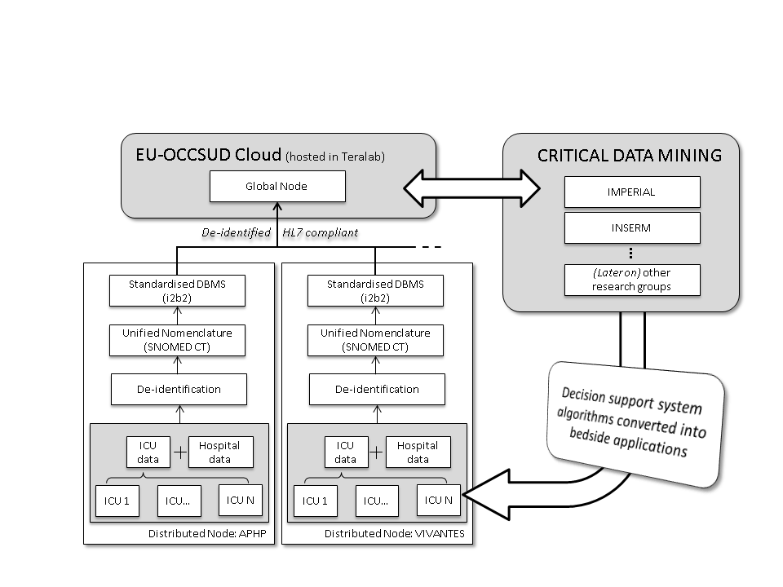
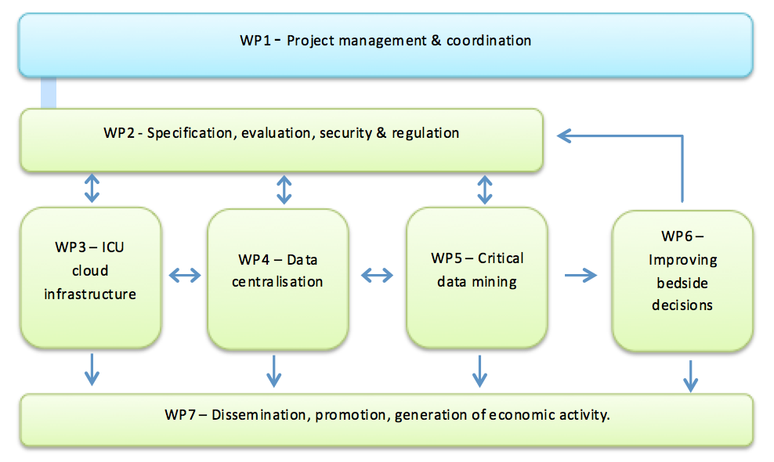
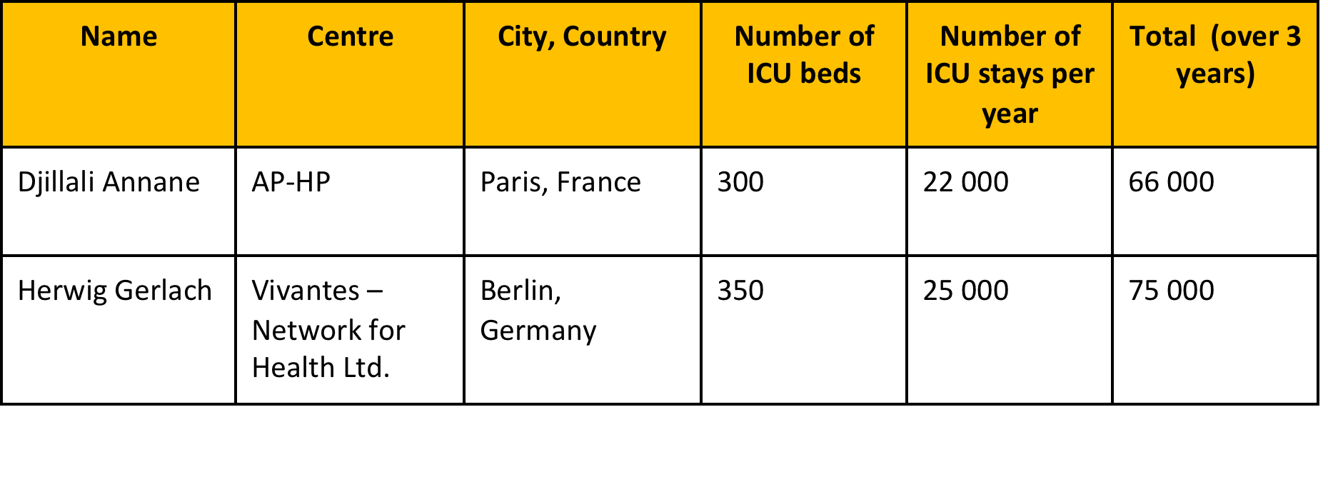
OCCSUD project

Slide 43
What do you absolutely need?
The dedicated support of:
hospital ITs (DSI)
Industrial partners (Agfa, Philips, …)
A strong institutional political will (AP-HP,CNIL)
Money (H2020 framework)
What will you build:
A database
A bridge between physicians and computer scientist cultures
A team of qualified and passionate scientists

Slide 44
Acknowldegments
Roger Mark & Leo Anthony Celi
Members of Laboratory of Computational Physiology (LCP – MIT) – Past and present
Members of the Oxford Institute of Biomedical Engineering (IBME)
All the many collaborators to the cause: US, EU, and beyond
Special thought to George Moody

